Slide 1
Electrical Heater project NASR-49 group
Team Members:
Moataz Hassan Ahmed
Hany Mahmoud El Taweel

Slide 2
Introduction System Specifications
Temperature Setting:
Temperature range ( from 35 to 75 ℃)
Set Temperature using up and down buttons
Temperature Sensing:
Sense temperature of the container
Get average value of every 10 readings
control heater and cooler using set temperature
ON/OFF Behavior:
system is off by default
System switches between ON and OFF when ON /OFF button is pressed
Heating/Cooling Elements:
Heater is ON and Cooler is OFF if readings is less than the set temperature by 5℃
Cooler is ON and Heater is OFF if readings is more than the set temperature by 5℃

Slide 3
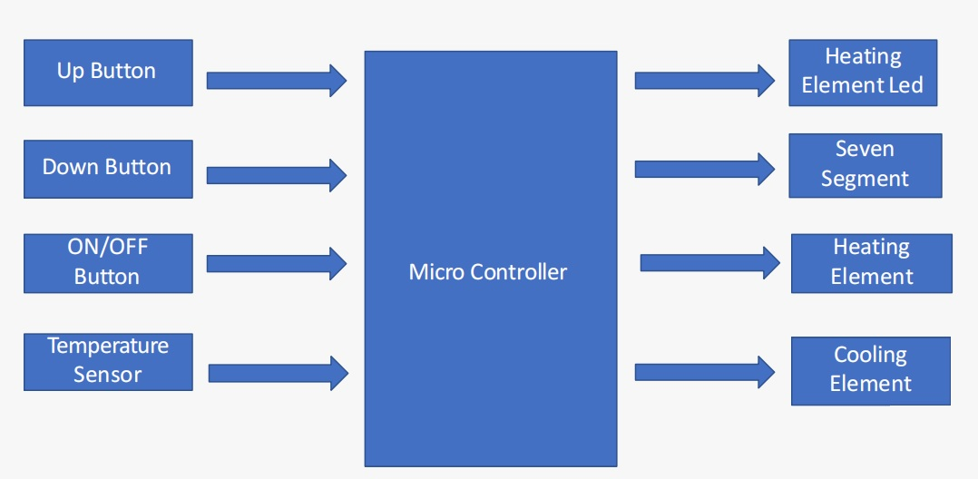
Hardware

Slide 4
Used Components
Temp sensor (NTC THERMISTORS Temperature sensor)
Cooling Element (Fan).
Heating Element (Copper wire +Heat Shrink +Nichrome wire from old heater (Solder Iron)).
Battery.
Internal EEPROM.
7-segments.
LEDs.
Push Buttons.
Relay.

Slide 5
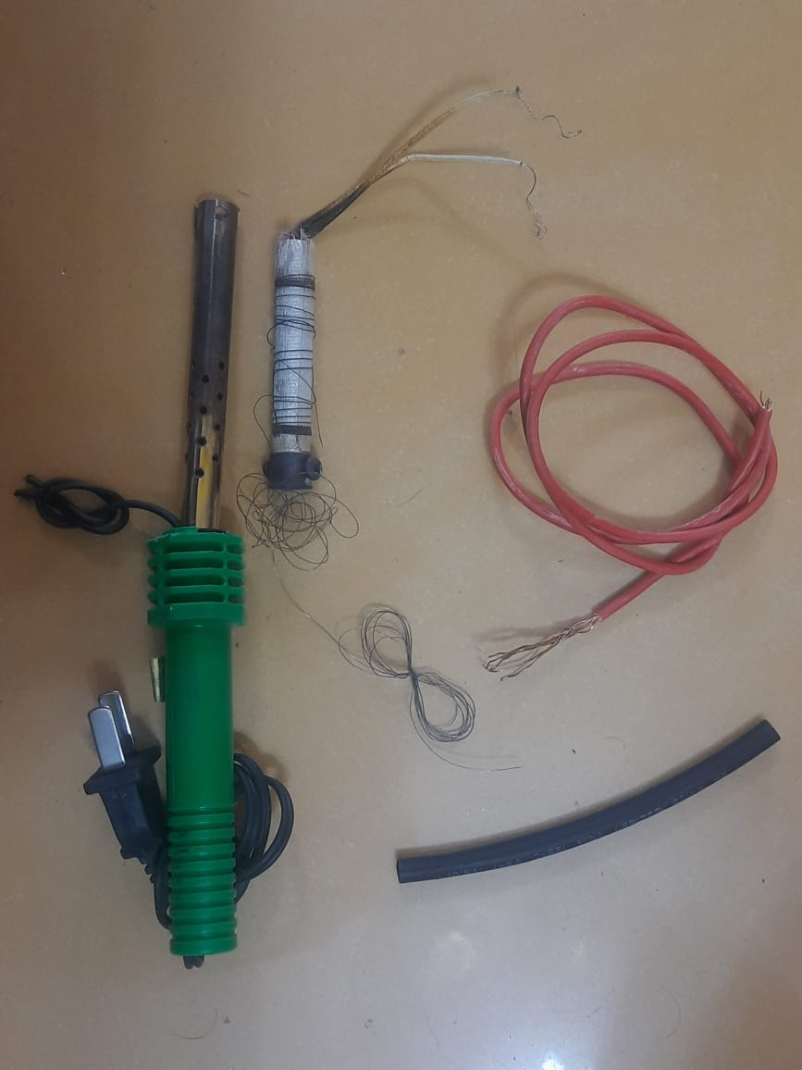
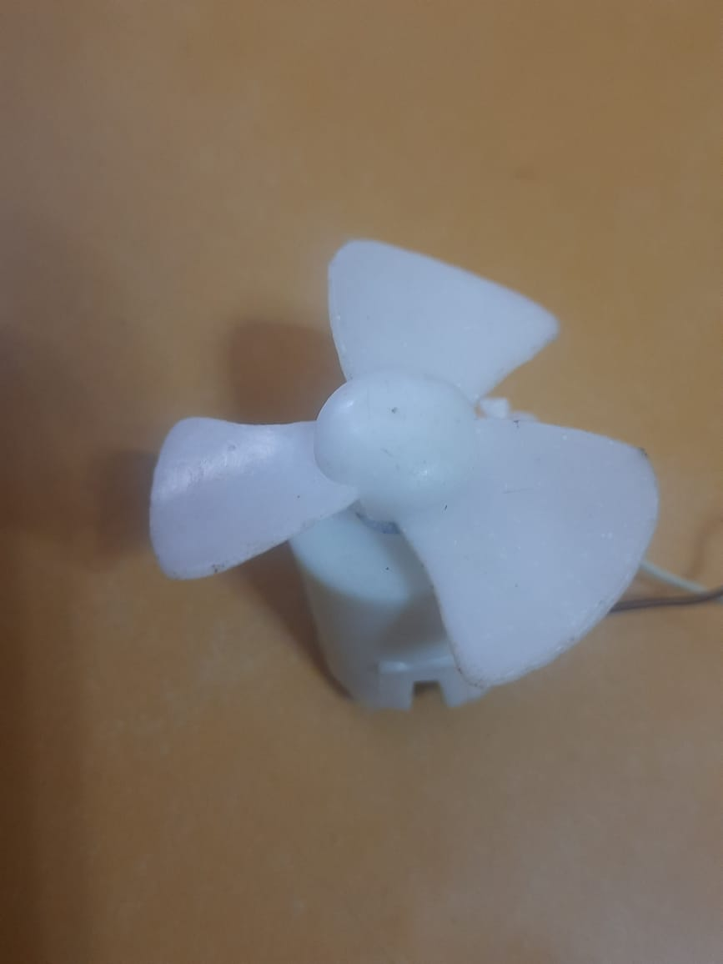
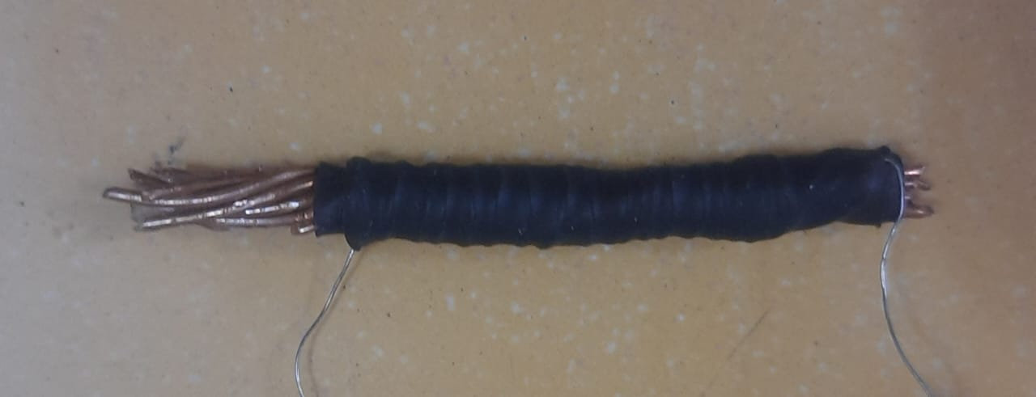
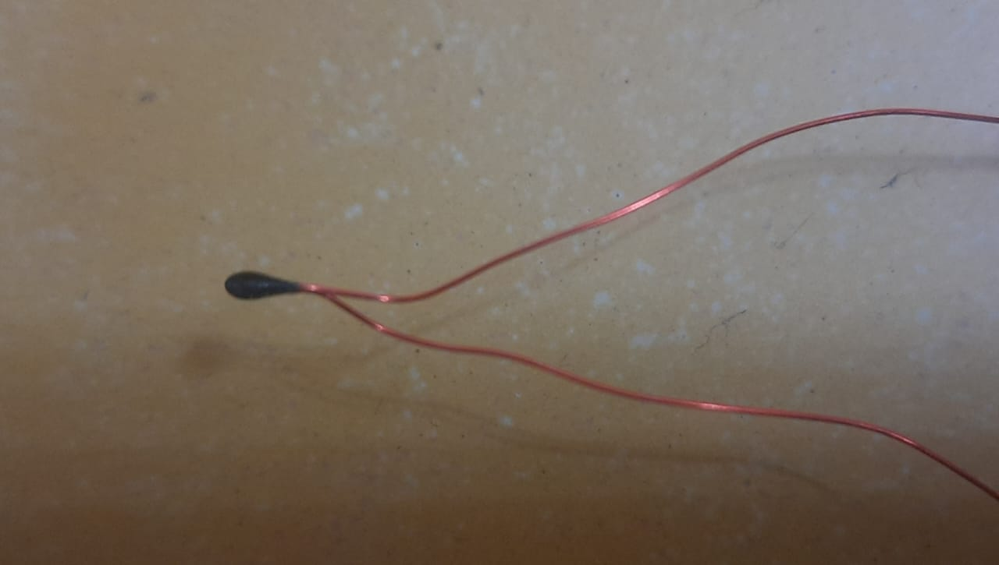
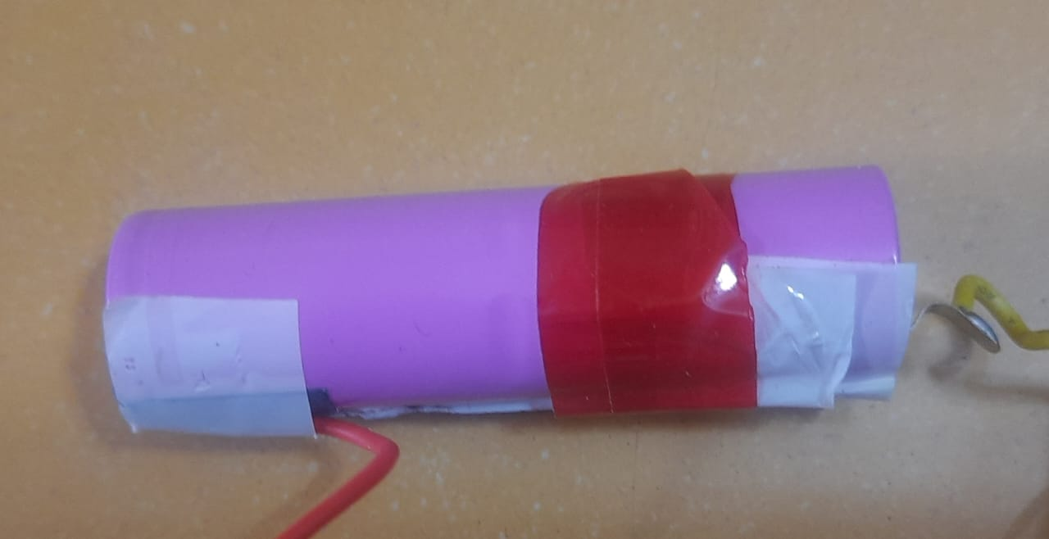
External Components
Heater ,Fan , NTC, Battery

Slide 6
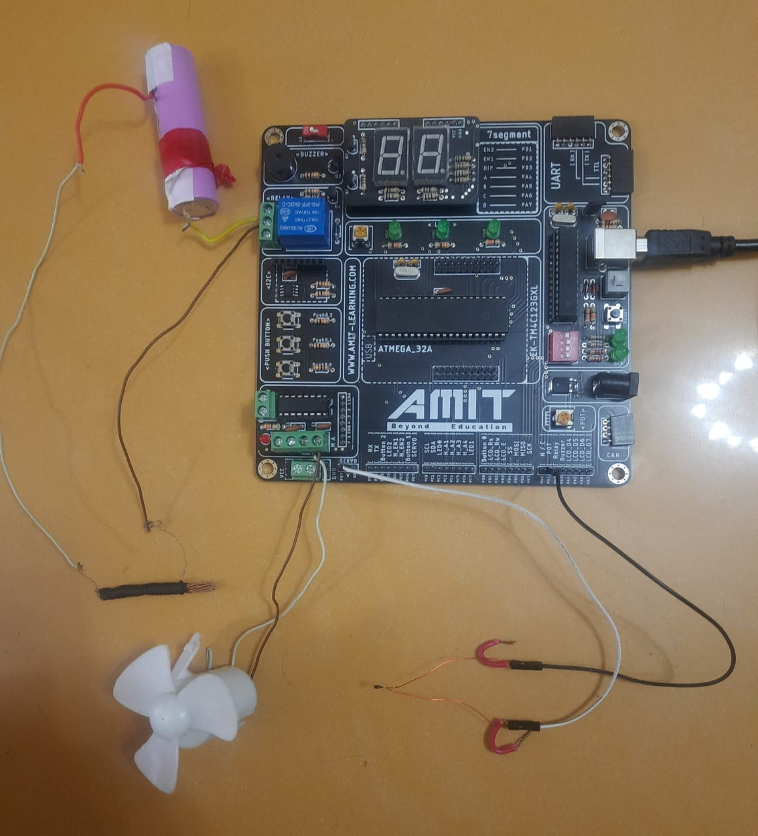

Slide 7
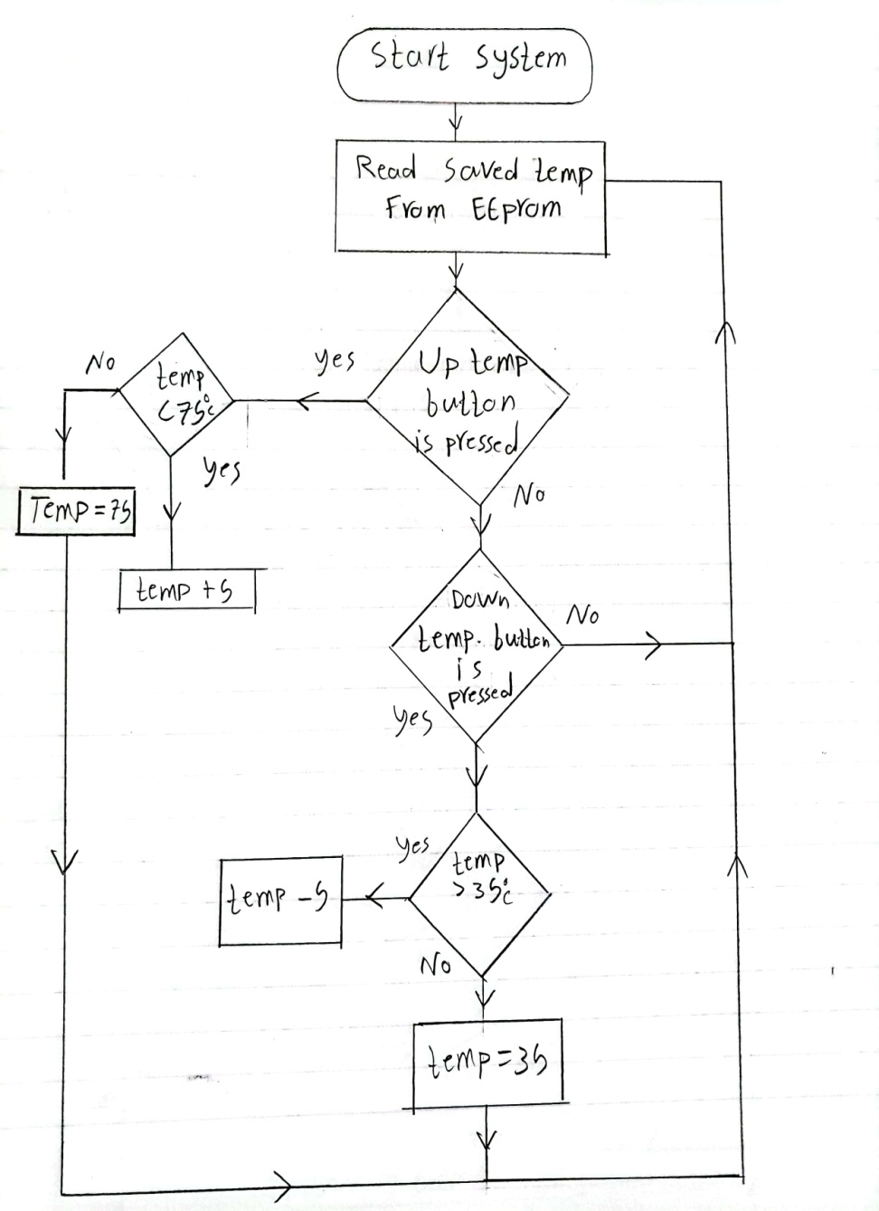
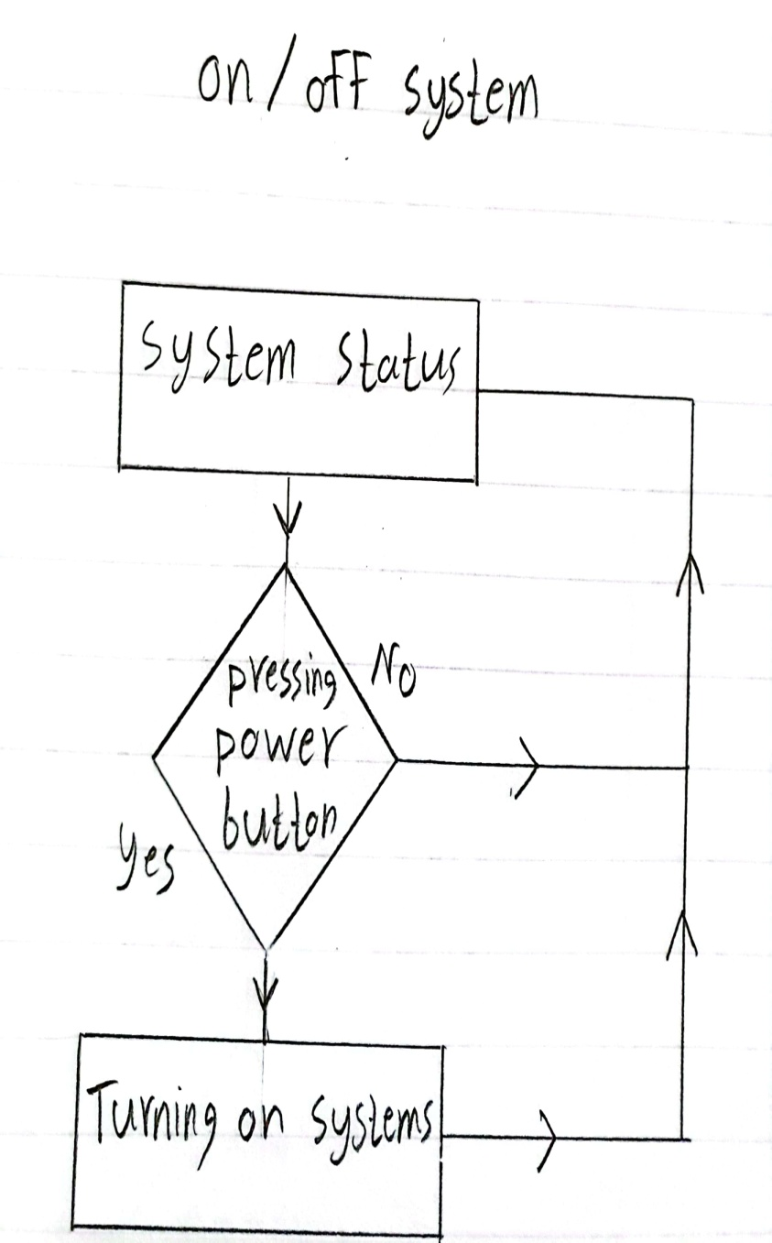
Flowcharts

Slide 8
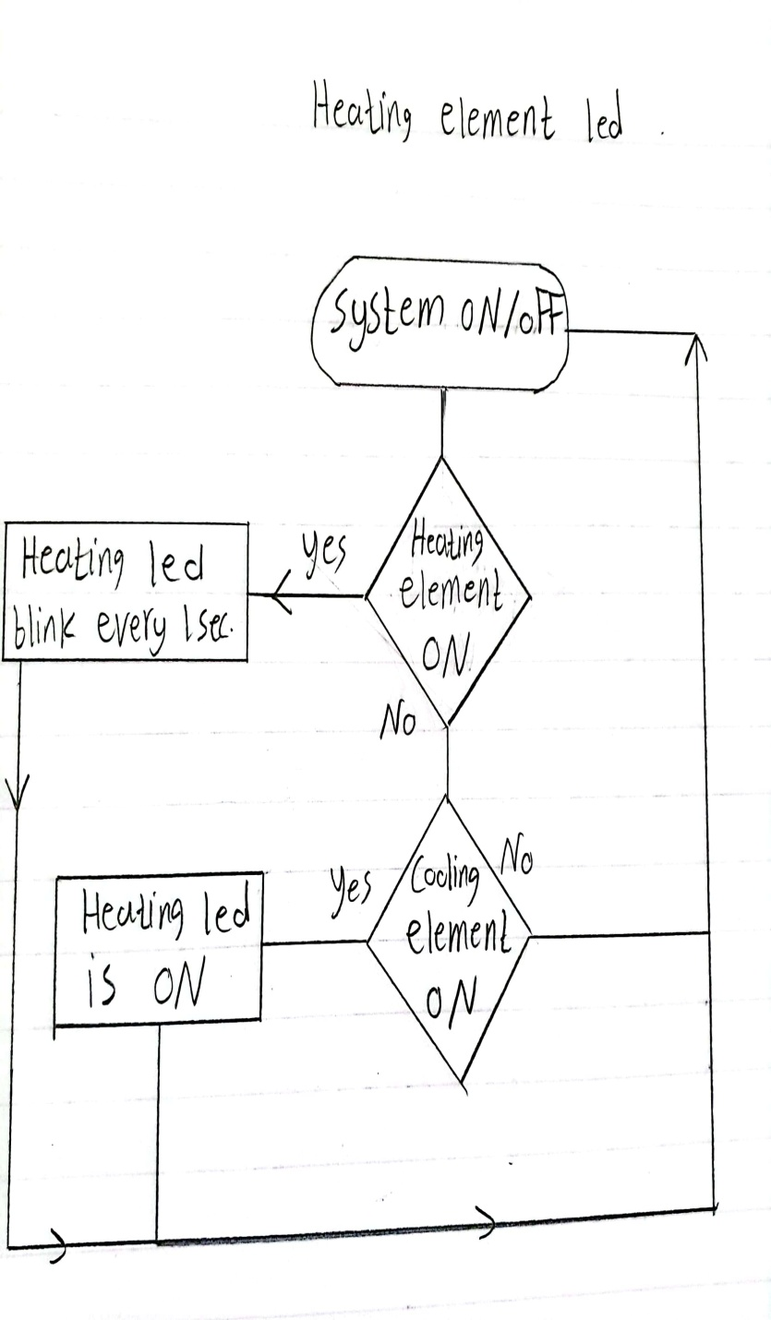
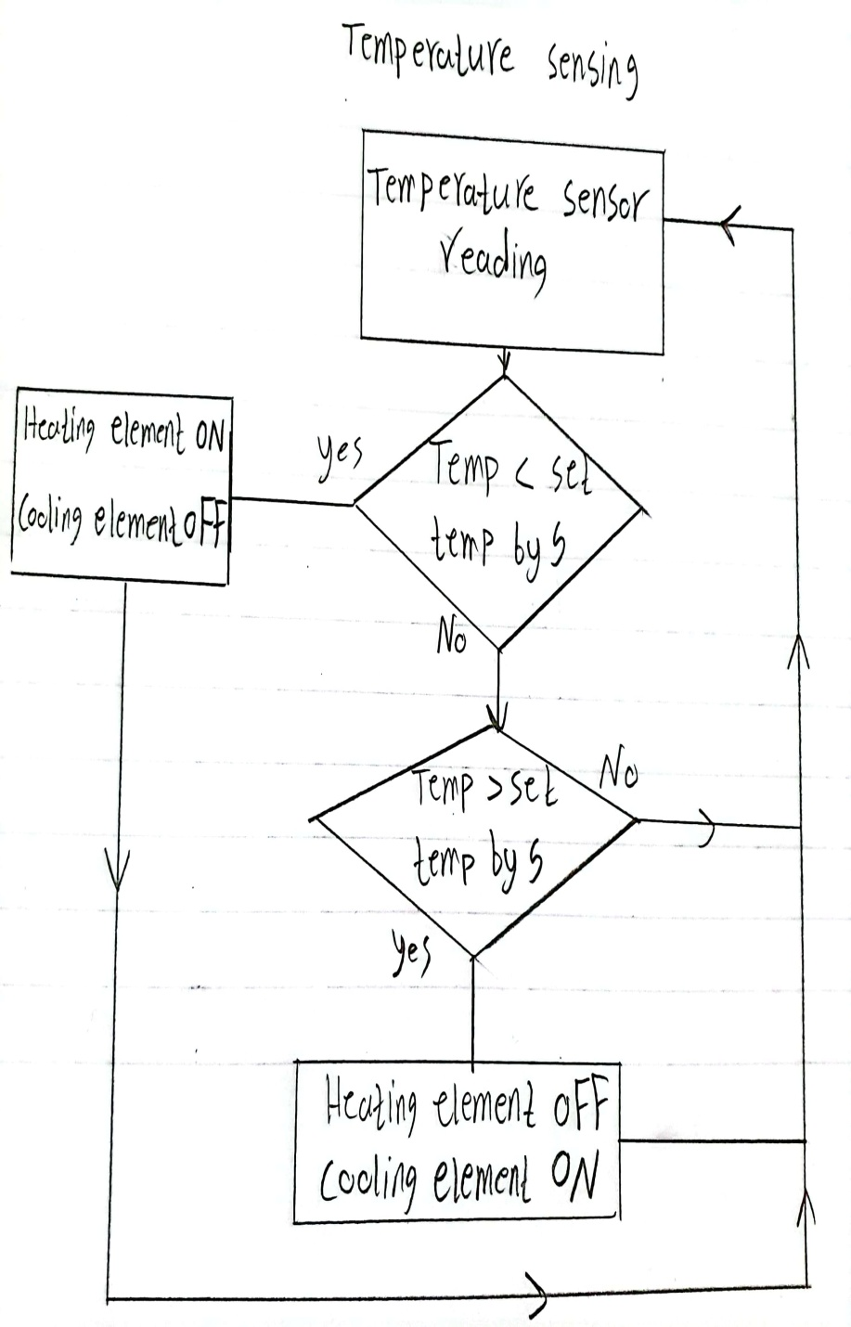

Slide 9
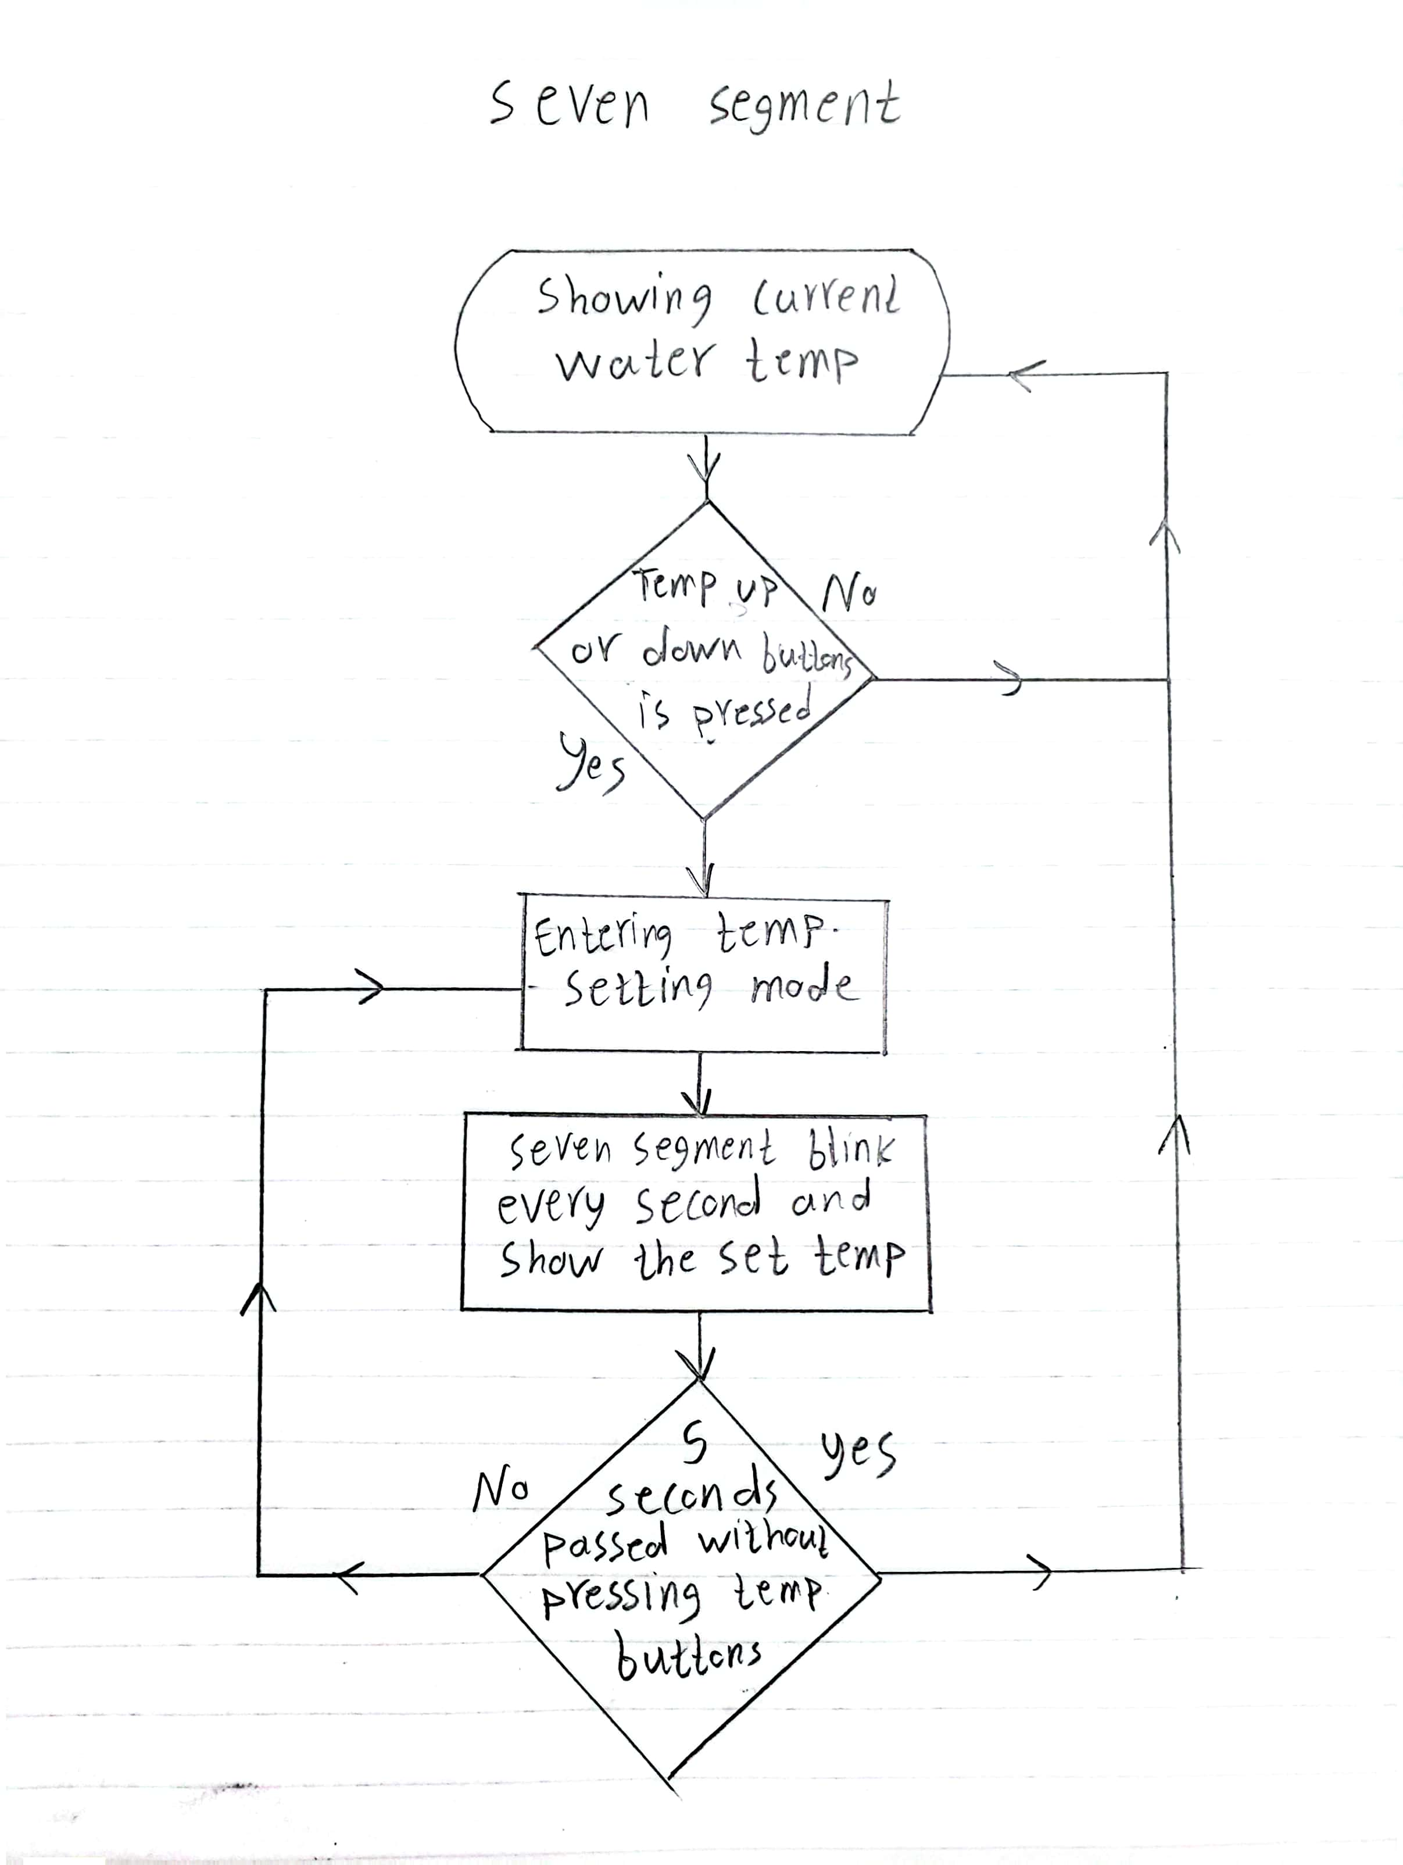

Slide 10


